Slide 1
Energy Storage Solutions March 2024 Contractor Training

Slide 2
Agenda
Quick Overview of ESS
Incentive Calculator
Salesforce Training
Website Walkthrough

Slide 3
PURA Updates
C&I Upfront Incentive Approval Pause
"...on June 15th, 2024, the Program Administrators shall pause all commercial passive dispatch enrollments in the Program until the Authority determines the commercial upfront incentives for the remainder of Tranche 2 and for Tranche 3."
Passive dispatch enrollments will pause until a decision is made during the Year 4 Program Review in Dkt. No. 24-08-05
Application Submission Timelines
Estimated Upfront Incentive < $500,000: Submit complete incentive application by May 31
Estimated Upfront Incentive ≥ $500,000: Submit complete incentive application by May 8

Slide 4
PURA Updates
Application Process Working Group (APWG)
APWG Report submitted to PURA on March 15th
Report still under review
Expect some changes to the application flow

Slide 5
Energy Storage Solutions
9-year declining incentives – Goal of 580 MW behind-the-meter storage for residential and non-residential end-use customers
Statewide goal of 1000 MW, including front-of-the-meter
CUSTOMER CLASS​ | 2022-2024​ | 2025-2027​ | 2028-2030​ | TOTAL​
Residential​ | 50 MW​ | 100 MW​ | 140 MW​ | 290 MW​
Commercial and Industrial​ | 50 MW​ | 100 MW​ | 140 MW​ | 290 MW​
Total​ | 100 MW​ | 200 MW​ | 280 MW​ | 580 MW ​

Slide 6
Program Design
Customer Classes:
Residential customer classes: Standard, Underserved, and Low-Income Households
Commercial/industrial customer classes: Small, Medium, Large (based on demand)
Systems installed through this program can receive two incentives:
Program Element | Design Item | Summer | Winter
Upfront Incentive (Passive Dispatch) | Events per Season | All non-holiday weekdays (~60) | N/A
 | Months | June, July & August | N/A
 | Event Duration | 5 Hours | N/A
 | Anticipated Dispatch Window | 3 PM to 8 PM | N/A
Performance-Based Incentive (Active Dispatch) | Events per Season | 30 to 60 | 1 to 5
 | Months | June through September | November through March
 | Event Duration | 1 - 3 hours | 1 - 3 hours
 | Anticipated Dispatch Window | Noon to 9 PM (All Days) | Noon to 9 PM (All Days)
Notes:
Now onto program design and how we plan to incentivize customers to install battery storage.
The program has two incentive types: upfront for passive dispatch, and performance-based for active dispatch.
Passive dispatch means that, during the scheduled times of 3 to 8 PM during summer weekdays, the battery will be pre-programmed to discharge in order to meet on-site demand. This means the battery will charge at night or during hours that aren’t particularly stressful on the grid, and meet some of the customer’s load during the day when the grid can be under strain. This can help a non-residential customer save on demand charges, and it will help avoid putting too much strain on the grid during those peak hours.
In exchange for programming your battery to do this 10 years, the program will administer an upfront incentive, which I’ll show an example of in a few slides.
The other incentive type is called active dispatch. In that case, the grid operator can predict an event (such as a very hot summer day where electric demand will be very high) and send a signal to the batteries to discharge to the grid. We anticipate these types of events happening 30-60 times each summer and 1-5 times each winter. Your participation in these events will be averaged out and calculated in the incentive I’ll show you in a few slides.

Slide 7
Residential Incentive Levels
Upfront Incentive Levels (Installed 2022-2024)*
Capacity Block (MW) | Standard | Underserved | Low-Income
10 | $250/kWh | $450/kWh | $600/kWh
15 | $212.5/kWh | $450/kWh | $600/kWh
25 | $162.5/kWh | $450/kWh | $600/kWh
Grid-Edge Adder | +50% | +50% | +50%
Performance Incentive Levels (Installed 2022-2024)
Summer, Years 1-5 | Winter, Years 1-5 | Summer, Years 6-10 | Winter, Years 6-10
$200/kW | $25/kW | $115/kW | $15/kW
*Residential Upfront Incentive capped at $16,000 or 50% of total cost (whichever is less)
Notes:
Ed
As we discussed earlier, incentives are split into two categories: upfront for passive dispatch and performance-based for active dispatch.
Our upfront incentive levels will go in Steps, similar to RSIP, based on total approved capacity. The first Step will be 10 MW, then 15, then 25 for steps 2 and 3. We expect these steps to be active through the first three years of the program's operation, approximately one step per year as things ramp up.
The incentives for residential customers are set for market rate, and then multiplied by 1.5 and 2 for underserved and low-income customers, respectively. Step 1 upfront incentives are $200, $300, $400 for standard, underserved, and low-income customers respectively. We expect that Step 1 will accommodate up to 1,400 residential customers, assuming about 14 kWh per project.

Slide 8
Commercial Incentive Levels
Upfront Incentive Levels (Installed 2022-2024)*
Customer Class | Small C&I | Medium C&I | Large C&I
Peak Demand | <200 kW | 200-500 kW | >500 kW
Step 2 Incentive Rates | $200/kWh | $175/kWh | $100/kWh
Priority Customer Adder | +25% | +25% | +25%
Upfront Incentive (Installed 2022-2024)*
Performance Incentive Levels (Installed 2022-2024)
Summer, Years 1-5 | Winter, Years 1-5 | Summer, Years 6-10 | Winter, Years 6-10
$200/kW | $25/kW | $115/kW | $15/kW
*Commercial and Industrial project approvals will pause on June 15th, 2024; Upfront Incentive capped at 50% of total cost
Notes:
Ed
As we discussed earlier, incentives are split into two categories: upfront for passive dispatch and performance-based for active dispatch.
Our upfront incentive levels will go in Steps, similar to RSIP, based on total approved capacity. The first Step will be 10 MW, then 15, then 25 for steps 2 and 3. We expect these steps to be active through the first three years of the program's operation, approximately one step per year as things ramp up.
The incentives for residential customers are set for market rate, and then multiplied by 1.5 and 2 for underserved and low-income customers, respectively. Step 1 upfront incentives are $200, $300, $400 for standard, underserved, and low-income customers respectively. We expect that Step 1 will accommodate up to 1,400 residential customers, assuming about 14 kWh per project.

Slide 9
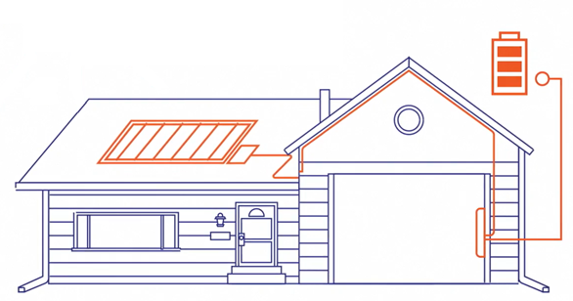
Approved Technology
Eligible Equipment List
Residential BESS OEMs:
Enphase
Generac
Fortress
Franklin WH
SunPower
Cadenza Innovation
Electriq Power
Homegrid Energy
PylonTech
Stackrack
Sol-Ark (battery-agnostic inverter)
C&I BESS OEMs:
Cadenza
Caterpillar
ELM Fieldsight
Milton CAT
Socomec
Tesla (Megapack only)
BYD Energy Storage
Canadian Solar
Generac Power Systems
Relyion Energy

Slide 10
Incentive Reservations & Estimates

Slide 11
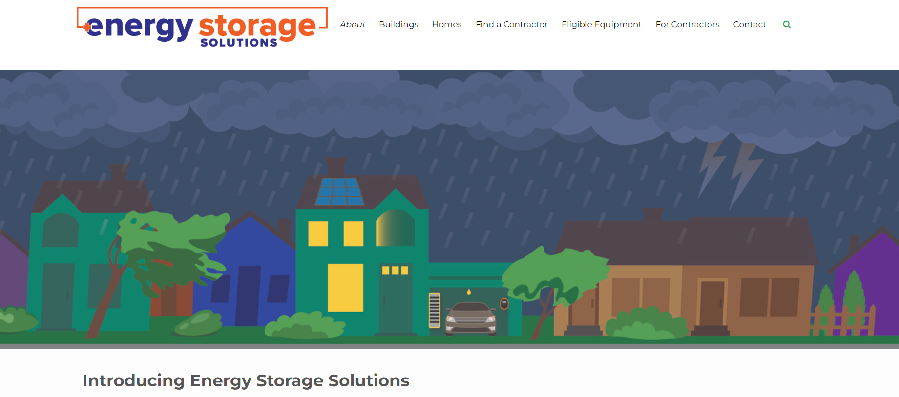
Website Walkthrough

Slide 12
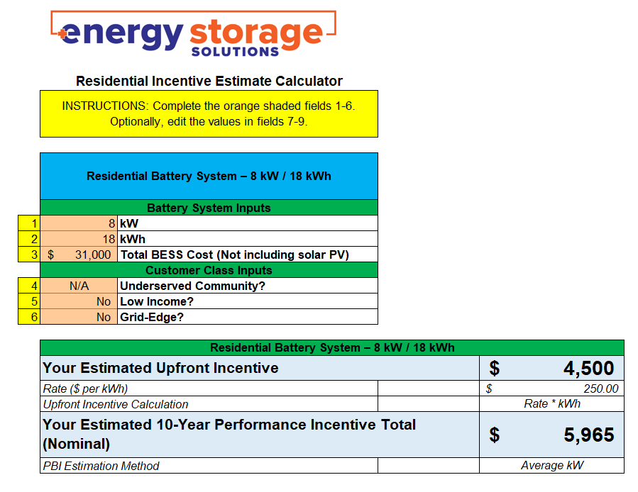
Incentive Calculator

Slide 13
Salesforce Demo
Energy Storage Solutions Contractor Portal

Slide 14
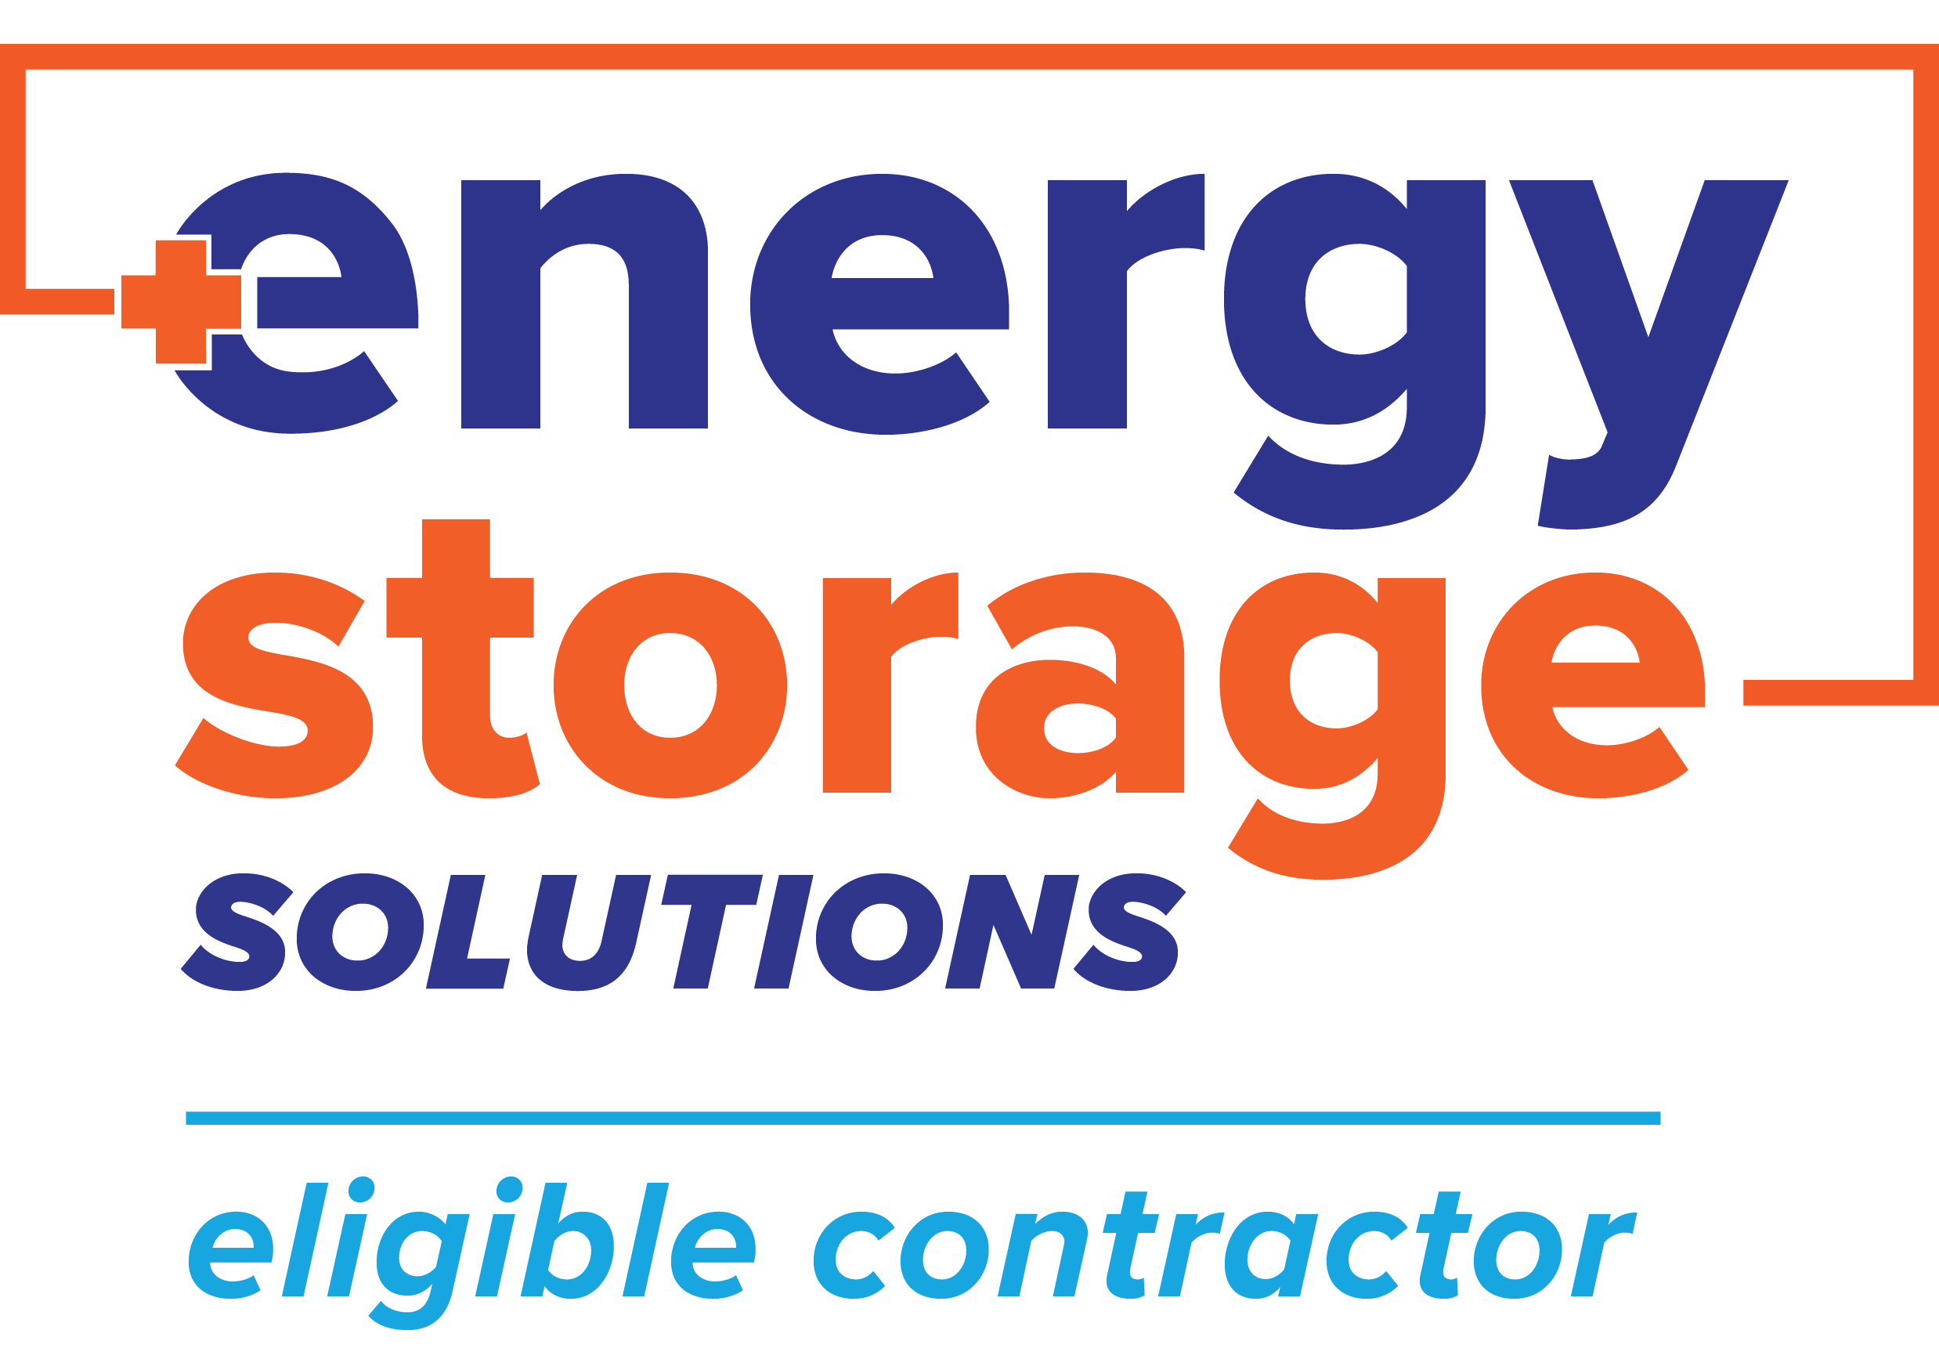
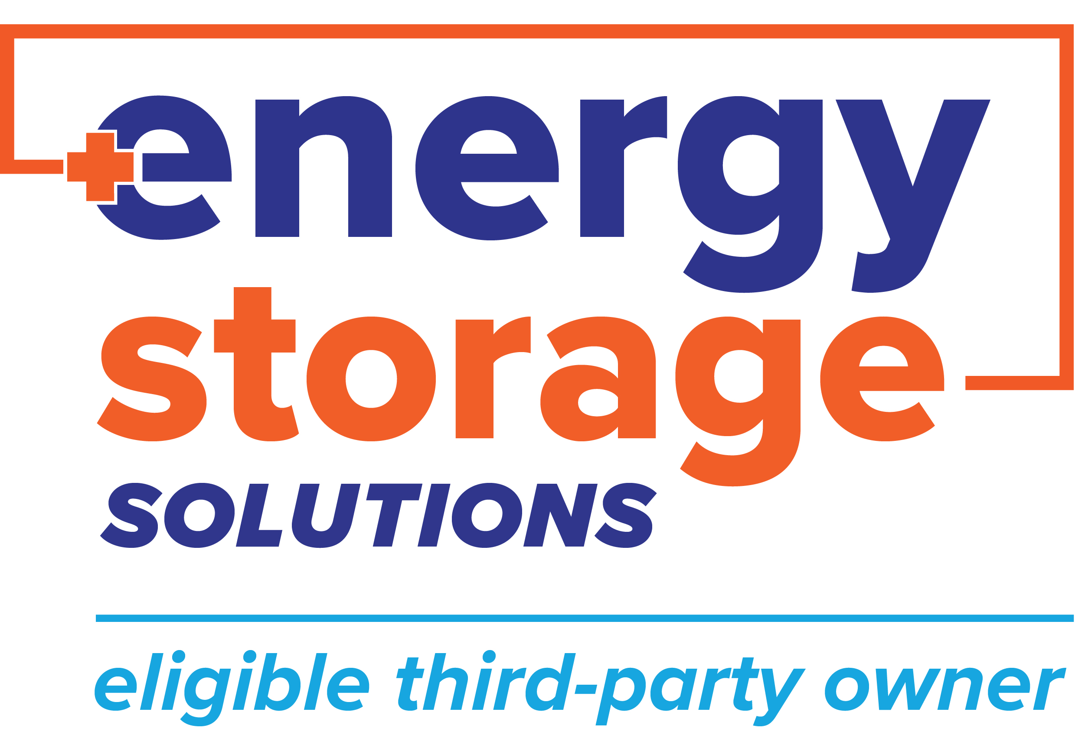
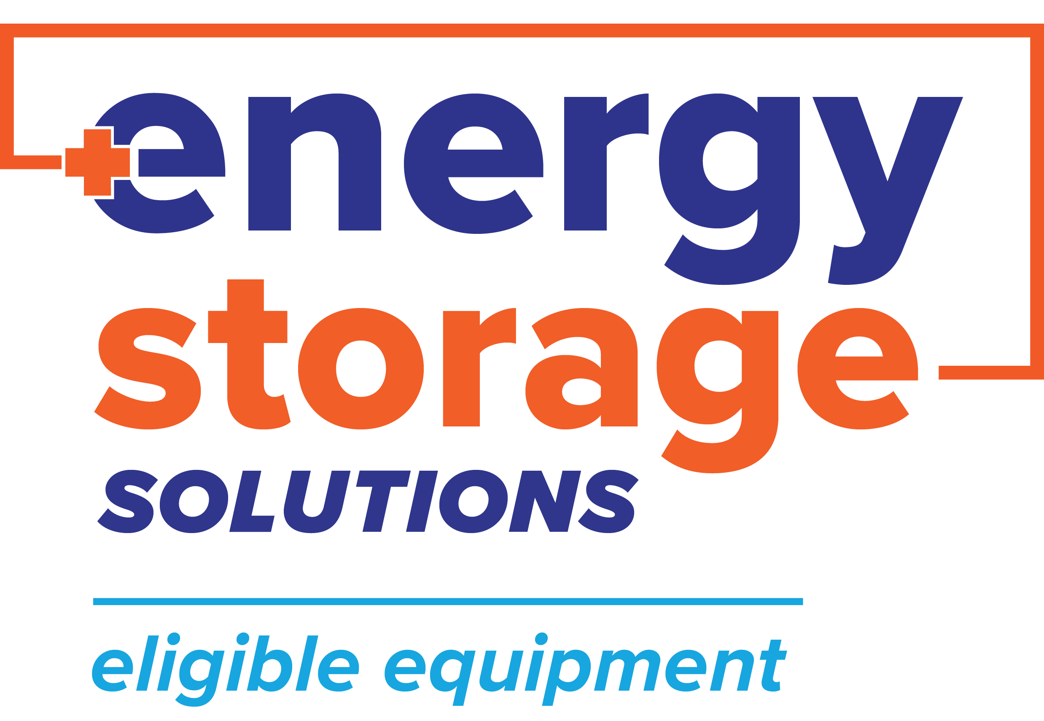
Energy Storage Solutions Cobranding
Use the Energy Storage Solutions logos in your marketing materials!
Visit www.energystoragect.com/cobranding-terms-and-conditions-form to request access

Slide 15
Questions?

Slide 16
Appendix

Slide 17
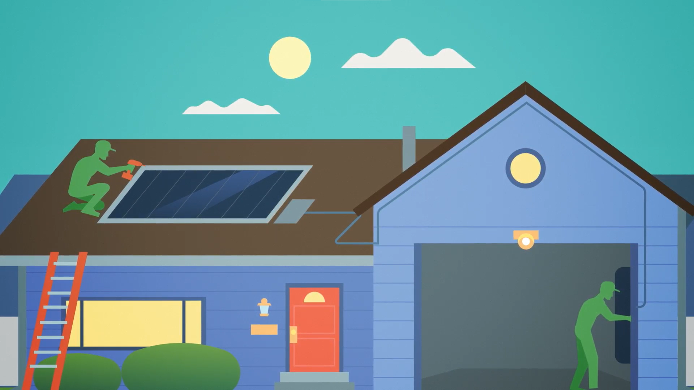

Slide 18
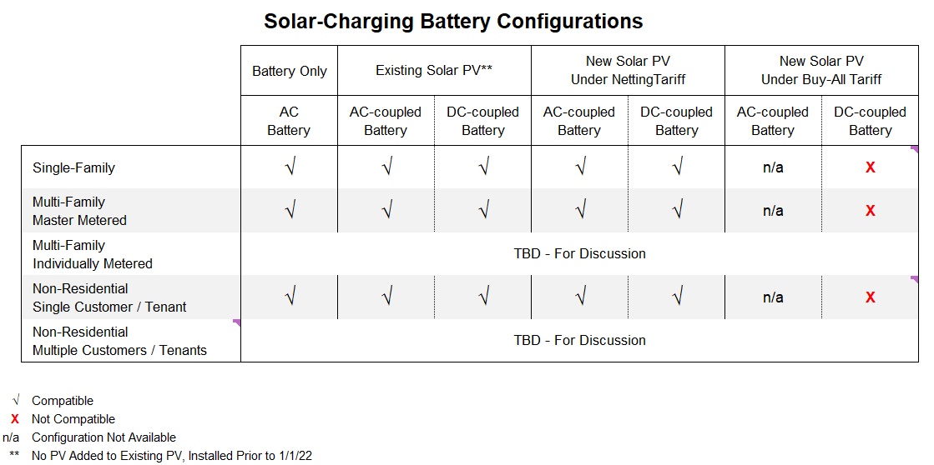
Battery Configurations

Slide 19
Application Approval Process Flow (without Salesforce stage names)
Check Eligible Battery List
New Technology Application (OEM Completes)
Program Admin Review
Technology
Pre-Approval
Integration with DERMS
ELIGIBILITY
Program Admins
Not on the list
Contractor
Inspector
Battery Vendor
On the list
Host Customer
Eligible Contractor Submits Project Application
CGB Application Review
Approval
Reservation of Funds Letter
Battery Installed & Energized
APPLICATION
Rejection
Letter of Rejection
Eligible Contractor Submits Completion Application
CGB Completion Review
Project moves into Inspection
Approval
COMPLETION
Rejection
Letter of Rejection
Project Inspection
Inspector completes Inspection
Battery Verification in DERMS
Confirmation of Funds Letter
Upfront Incentive Payment to Contractor
Program Participation
INSPECTION & VERIFICATION
Approval
Rejection
Inspection Corrections

Slide 20
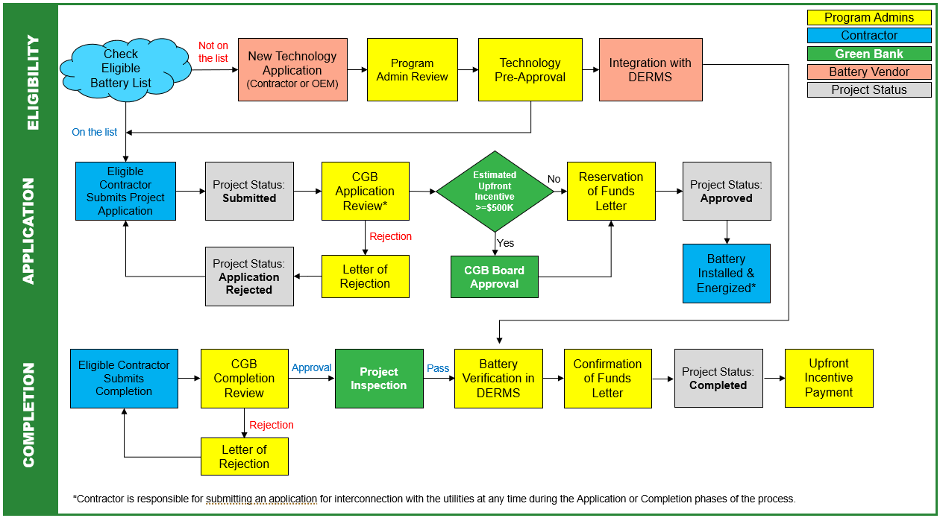
Process Flow

Slide 21
Application Approval Process Flow
Check Eligible Battery List
New Technology Application (OEM Completes)
Program Admin Review
Technology
Pre-Approval
Integration with DERMS
ELIGIBILITY
Program Admins
Not on the list
Contractor
Inspector
Battery Vendor
On the list
Host Customer
Eligible Contractor Submits Project Application
CGB Application Review
Approval
Reservation of Funds Letter
Battery Installed & Energized
APPLICATION
Rejection
Letter of Rejection
Eligible Contractor Submits Completion Application
CGB Completion Review
Project moves into Inspection
Approval
COMPLETION
Rejection
Letter of Rejection
Project Inspection
Inspector completes Inspection
Battery Verification in DERMS
Confirmation of Funds Letter
Upfront Incentive Payment to Contractor
Program Participation
INSPECTION & VERIFICATION
Approval
Rejection
Inspection Corrections

