Slide 1
Energy Storage Solutions July 2024 Contractor Training

Slide 2
Agenda
PURA updates
Quick Overview of ESS
Website Walkthrough
Incentive Calculator
Salesforce Training
Questions & Discussion

Slide 3
PURA Updates
C&I Upfront Incentive Approval Pause
"...on June 15th, 2024, the Program Administrators shall pause all commercial passive dispatch enrollments in the Program until the Authority determines the commercial upfront incentives for the remainder of Tranche 2 and for Tranche 3.“
“…The deadline for upfront incentive approval of C&I projects currently in the queue shall be extended to Monday, June 24, 2024.”
Passive dispatch enrollments will pause until a decision is made during the Year 4 Program Review in Dkt. No. 24-08-05
Application Submissions
You may continue submitting applications to reserve your spot in the queue; they will not be reviewed until the next tranche of capacity opens and will be subject to new incentive rates.
Active-Only applications reviews and approvals are not subject to the pause and may proceed with submissions.

Slide 4
PURA Updates
Application Process Working Group (APWG)
APWG Report submitted to PURA on March 15th
Approved April 4th
Expect some changes to the application flow
http://www.dpuc.state.ct.us/dockcurr.nsf/All/CA615213D2C0250F85258AF5004C046C?OpenDocument
Recommended revisions to Program Manual and Program Documents to be filed August 1st
PURA invites stakeholder comments for consideration in Docket No. 24-08-05, Annual Energy Storage Solutions Program Review – Year 4

Slide 5
Energy Storage Solutions
9-year declining incentives – Goal of 580 MW behind-the-meter storage for residential and non-residential end-use customers
Statewide goal of 1000 MW, including front-of-the-meter
CUSTOMER CLASS​ | 2022-2024​ | 2025-2027​ | 2028-2030​ | TOTAL​
Residential​ | 50 MW​ | 100 MW​ | 140 MW​ | 290 MW​
Commercial and Industrial​ | 50 MW​ | 100 MW​ | 140 MW​ | 290 MW​
Total​ | 100 MW​ | 200 MW​ | 280 MW​ | 580 MW ​

Slide 6
Program Design
Customer Classes:
Residential customer classes: Standard, Underserved, and Low-Income Households
Commercial/industrial customer classes: Small, Medium, Large (based on demand)
Systems installed through this program can receive two incentives:
Program Element | Design Item | Summer | Winter
Upfront Incentive (Passive Dispatch) | Events per Season | All non-holiday weekdays (~60) | N/A
 | Months | June, July & August | N/A
 | Event Duration | 5 Hours | N/A
 | Anticipated Dispatch Window | 3 PM to 8 PM | N/A
Performance-Based Incentive (Active Dispatch) | Events per Season | 30 to 60 | 1 to 5
 | Months | June through September | November through March
 | Event Duration | 1 - 3 hours | 1 - 3 hours
 | Anticipated Dispatch Window | Noon to 9 PM (All Days) | Noon to 9 PM (All Days)

Slide 7
Residential Incentive Levels
Upfront Incentive Levels (Installed 2022-2024)*
Capacity Block (MW) | Standard | Underserved | Low-Income
10 | $250/kWh | $450/kWh | $600/kWh
15 | $212.5/kWh | $450/kWh | $600/kWh
25 | $162.5/kWh | $450/kWh | $600/kWh
Grid-Edge Adder | +50% | +50% | +50%
Performance Incentive Levels (Installed 2022-2024)
Summer, Years 1-5 | Winter, Years 1-5 | Summer, Years 6-10 | Winter, Years 6-10
$200/kW | $25/kW | $115/kW | $15/kW
*Residential Upfront Incentive capped at $16,000 or 50% of total cost (whichever is less)

Slide 8
Commercial Incentive Levels
Upfront Incentive Levels (Installed 2022-2024)*
Customer Class | Small C&I | Medium C&I | Large C&I
Peak Demand | <200 kW | 200-500 kW | >500 kW
Step 2 Incentive Rates | $200/kWh | $175/kWh | $100/kWh
Priority Customer Adder | +25% | +25% | +25%
Upfront Incentive (Installed 2022-2024)*
PAUSED
Performance Incentive Levels (Installed 2022-2024)
Summer, Years 1-5 | Winter, Years 1-5 | Summer, Years 6-10 | Winter, Years 6-10
$200/kW | $25/kW | $115/kW | $15/kW
*Commercial and Industrial project approvals will pause on June 15th, 2024; Upfront Incentive capped at 50% of total cost

Slide 9
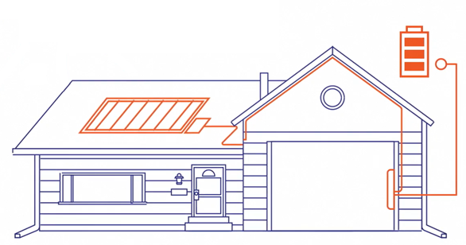
Approved Technology
Eligible Equipment List
Residential BESS OEMs:
Cadenza Innovation
Electriq Power
Enphase
Fortress Power
FranklinWH
Generac PWRcell
Homegrid Energy
Panasonic Corporation
PylonTech
Qcells
StackRack
SunPower
Sol-Ark (battery-agnostic inverter)
Tesla *(Tesla Powerwall 2, Powerwall +, Powerwall 3 can only enroll in Active Dispatch and are not eligible for the Upfront Incentive through Passive Dispatch.)
C&I BESS OEMs:
BYD Energy Storage
Cadenza Innovation
Caterpillar Inc.
Canadian Solar
ELM Fieldsight
Generac Power Systems
Milton CAT
Relyion Energy
Socomec
Tesla (Megapack 2 only)
New Technology Application

Slide 10
Salesforce Demo
Energy Storage Solutions Contractor Portal

Slide 11
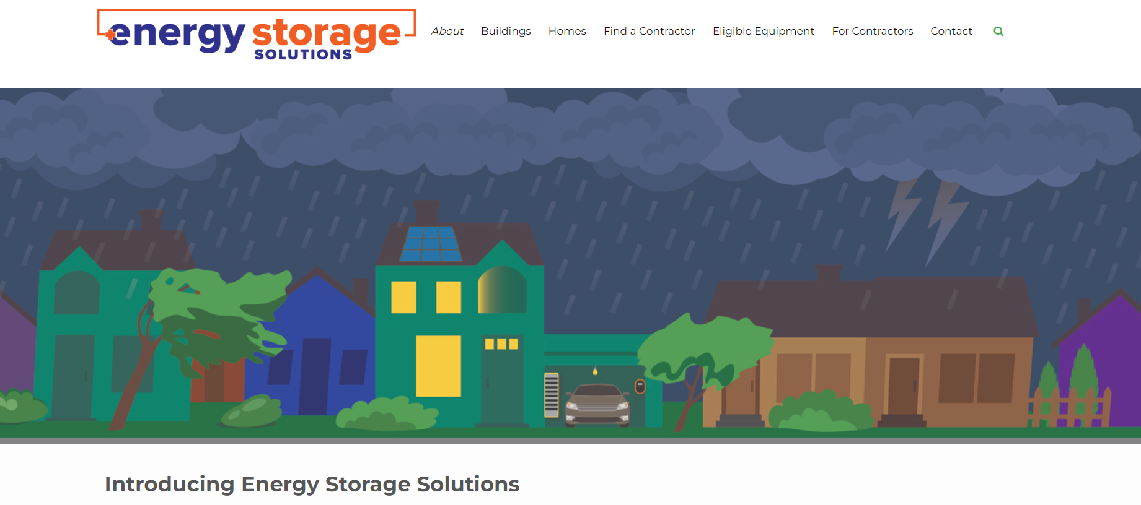
Website Walkthrough

Slide 12
Incentive Reservations & Estimates

Slide 13
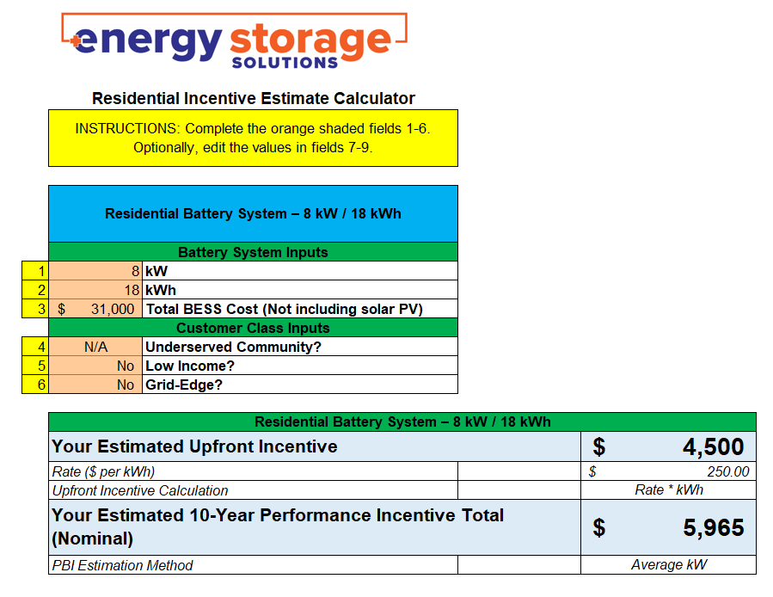
Incentive Calculator
Notes:
Next, we will take a quick look at the incentive calculator on our website, located under Contractor Resources.
Some key things to note:
ensure you are on the correct sheet within the workbook, one is for residential and the other is C&I;
also, the upfront incentive is accurate to utilize with sales agreements so long as you are inputting accurate data for the kWh, total battery cost, and customer class inputs;
the 10-year performance incentive total (nominal) is less accurate and should be disclosed as such to customers if you are presenting that in your sales process – this is due to many variables that can alter the performance incentive (number and timing of events called by the EDCs, recharge rate, weather, customer opt-outs). It is imperative that you convey to customers the performance-based incentive is solely an estimate and does not reflect actual expected payouts.
For the C&I upfront incentive, cell C16 will confirm if the incentive cap is exceeded – C&I systems are limited in power (kW) and eligible to receive an upfront incentive up to 150% of the customer’s annual peak demand or 2 MW, whichever is greater; if the project exceeds this cap, the project must be redesigned, or the contractor may request a prorated Upfront incentive.

Slide 14
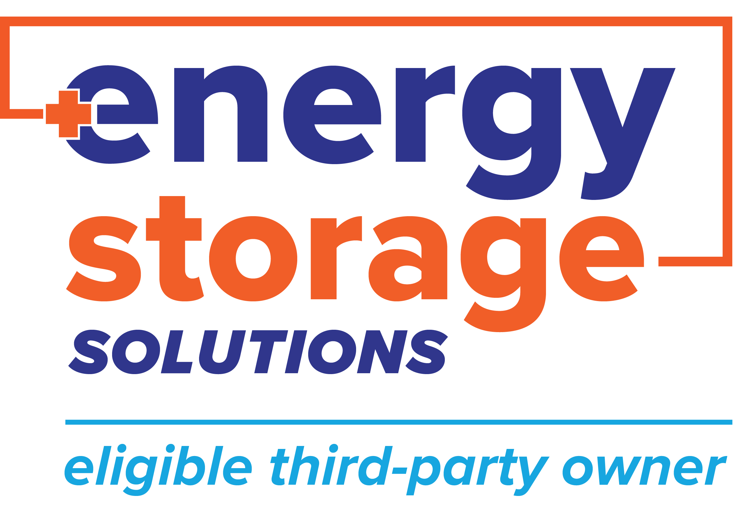
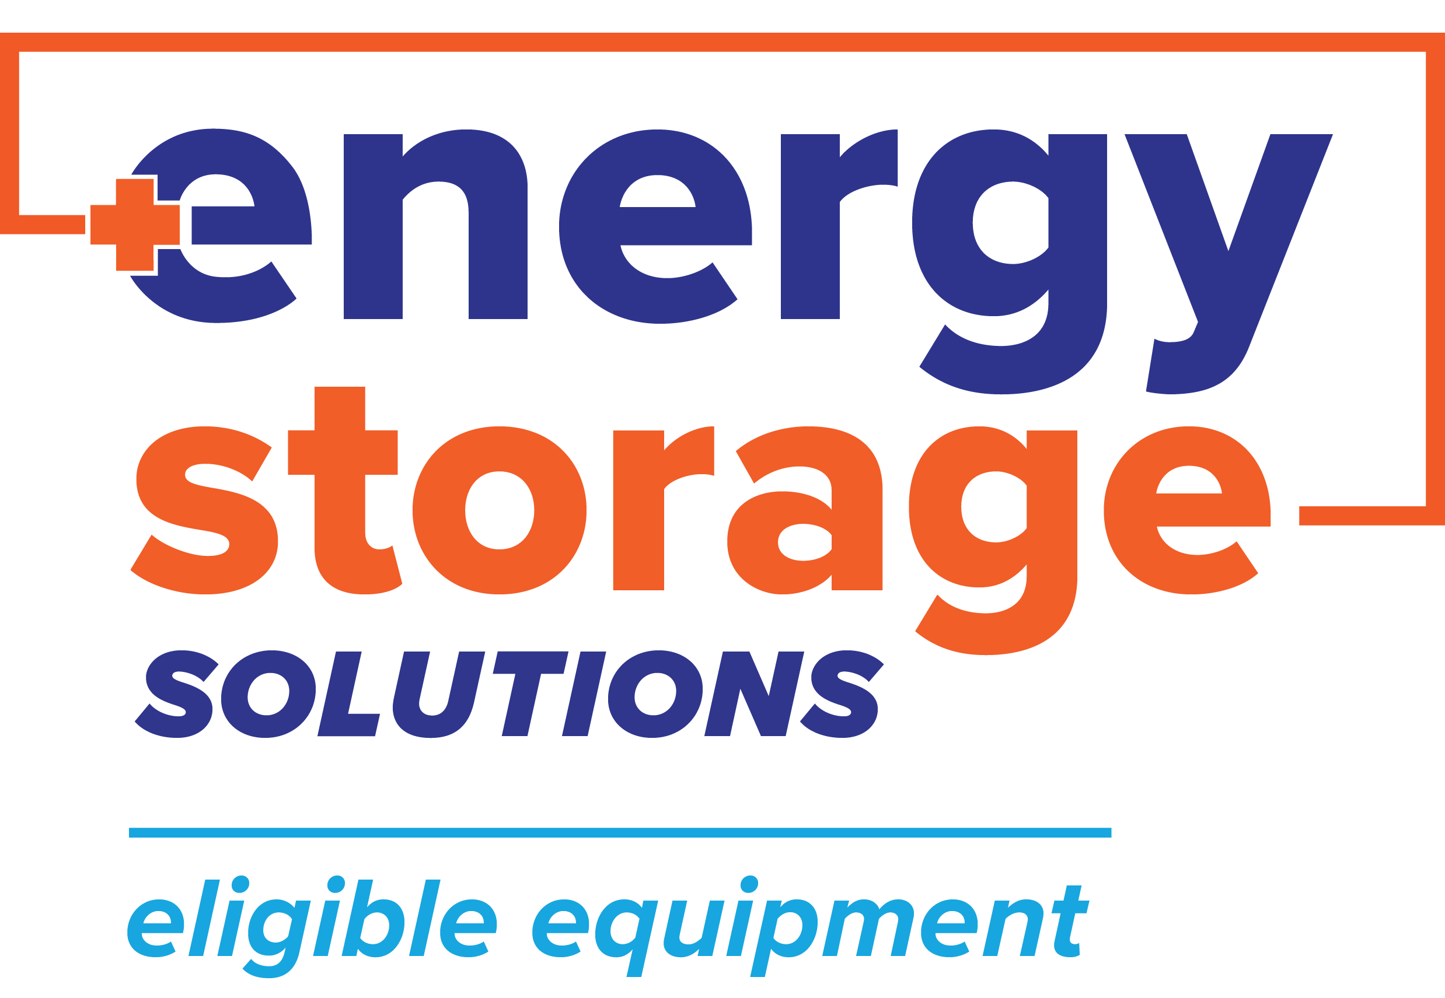
Energy Storage Solutions Cobranding
Use the Energy Storage Solutions logos in your marketing materials!
Visit www.energystoragect.com/cobranding-terms-and-conditions-form to request access
Notes:
Lastly, we have Energy Storage Solutions Cobranding for eligible contractors, third-party owners, and eligible equipment providers! You can sign up and request these badges via our website and filling out the simple form for our review and approval after reading and accepting the terms and conditions.

Slide 15
Questions?

Slide 16
Appendix

