Slide 1
Energy Storage Solutions October 2024 Contractor Training

Slide 2
Agenda
PURA updates
Quick Overview of ESS
Website Walkthrough
Incentive Calculator
Salesforce Training
Questions & Discussion

Slide 3
PURA Updates
Docket 24-08-05, Annual Energy Storage Solutions Program Review – Year 4 is underway!
The last Technical Meeting in Energy Storage Solutions Docket No. 24-08-05 was held Sept.12, 2024, at 9 am.
Tentative Date for Proposed Final Decision: November 1, 2024, at 4 PM
Tentative Date for Final Decision: December 04, 2024, at 10 AM
To view the full schedule of PURA events and previous Technical Meetings, please click the following link
100 Day Interconnection Sprint
- Interconnection Report due to PURA by 12/21/2024 in both ESS & NRES

Slide 4
PURA Updates
C&I Upfront Incentive Approval Pause
"...on June 15th, 2024, the Program Administrators shall pause all commercial passive dispatch enrollments in the Program until the Authority determines the commercial upfront incentives for the remainder of Tranche 2 and for Tranche 3.“
“…The deadline for upfront incentive approval of C&I projects currently in the queue shall be extended to Monday, June 24, 2024.”
Passive dispatch enrollments will pause until a decision is made during the Year 4 Program Review in Dkt. No. 24-08-05
Application Submissions
You may continue submitting applications to reserve your spot in the queue; they will not be reviewed until the next tranche of capacity opens and will be subject to those incentive rates.
Active-Only applications reviews and approvals are not subject to the pause and may proceed with submissions.

Slide 5
Energy Storage Solutions
9-year declining incentives – Goal of 580 MW behind-the-meter storage for residential and non-residential end-use customers
Statewide goal of 1000 MW, including front-of-the-meter
CUSTOMER CLASS​ | 2022-2024​ | 2025-2027​ | 2028-2030​ | TOTAL​
Residential​ | 50 MW​ | 100 MW​ | 140 MW​ | 290 MW​
Commercial and Industrial​ | 50 MW​ | 100 MW​ | 140 MW​ | 290 MW​
Total​ | 100 MW​ | 200 MW​ | 280 MW​ | 580 MW ​

Slide 6
Program Design
Customer Classes:
Residential customer classes: Standard, Underserved, and Low-Income Households
Commercial/industrial customer classes: Small, Medium, Large (based on demand)
Systems installed through this program can receive two incentives:
Program Element | Design Item | Summer | Winter
Upfront Incentive (Passive Dispatch) | Events per Season | All non-holiday weekdays (~60) | N/A
 | Months | June, July & August | N/A
 | Event Duration | 5 Hours | N/A
 | Anticipated Dispatch Window | 3 PM to 8 PM | N/A
Performance-Based Incentive (Active Dispatch) | Events per Season | 30 to 60 | 1 to 5
 | Months | June through September | November through March
 | Event Duration | 1 - 3 hours | 1 - 3 hours
 | Anticipated Dispatch Window | Noon to 9 PM (All Days) | Noon to 9 PM (All Days)

Slide 7
Residential Incentive Levels
Upfront Incentive Levels (Installed 2022-2024)*
Capacity Block (MW) | Standard | Underserved | Low-Income
10 | $250/kWh | $450/kWh | $600/kWh
15 | $212.5/kWh | $450/kWh | $600/kWh
25 | $162.5/kWh | $450/kWh | $600/kWh
Grid-Edge Adder | +50% | +50% | +50%
Performance Incentive Levels (Installed 2022-2024)
Summer, Years 1-5 | Winter, Years 1-5 | Summer, Years 6-10 | Winter, Years 6-10
$200/kW | $25/kW | $115/kW | $15/kW
*Residential Upfront Incentive capped at $16,000 or 50% of total cost (whichever is less)

Slide 8
Residential – Notes & Webinars
Sunnova customers may only enroll through Sunnova
*Only supporting Lease customers for eligible Tesla, Generac, and Enphase BESS
Unable to support Loan customers, but that is on their roadmap for the future
FranklinWH might become a Sunnova option next year, but at this time Sunnova-FranklinWH customers are unable to enroll and participate
Customer Information Webinars:
Please feel free to share this link with residential customers to learn more about the program and the benefits of battery energy storage systems. We have a previously recorded session from February 2024 and a new webinar is schedule for November 19 at 7 PM.
https://energystoragect.com/informational-webinars/

Slide 9
Commercial Incentive Levels
Upfront Incentive Levels (Installed 2022-2024)*
Customer Class | Small C&I | Medium C&I | Large C&I
Peak Demand | <200 kW | 200-500 kW | >500 kW
Step 2 Incentive Rates | $200/kWh | $175/kWh | $100/kWh
Priority Customer Adder | +25% | +25% | +25%
Upfront Incentive (Installed 2022-2024)*
PAUSED
Performance Incentive Levels (Installed 2022-2024)
Summer, Years 1-5 | Winter, Years 1-5 | Summer, Years 6-10 | Winter, Years 6-10
$200/kW | $25/kW | $115/kW | $15/kW
*Commercial and Industrial project approvals will pause on June 15th, 2024; Upfront Incentive capped at 50% of total cost

Slide 10
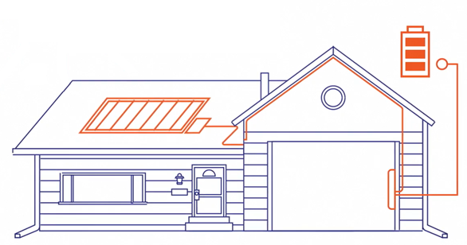
Approved Technology
Eligible Equipment List
Residential BESS OEMs:
Cadenza Innovation
EndurEnergy
Enphase
Fortress Power
FranklinWH
Generac PWRcell
Homegrid Energy
Panasonic Corporation
PylonTech + Sol-Ark 5k/15k inverters
Qcells
StackRack + Sol-Ark 12k/15k inverters
Tesla *(Tesla Powerwall 2, Powerwall +, Powerwall 3 can only enroll in Active Dispatch and are not eligible for the Upfront Incentive through Passive Dispatch.)
C&I BESS OEMs:
BYD Energy Storage
Cadenza Innovation
Caterpillar Inc.
Canadian Solar
ELM Fieldsight
Generac Power Systems
Milton CAT
Relyion Energy
Socomec
Tesla (Megapack 2 only)
New Technology Application

Slide 11
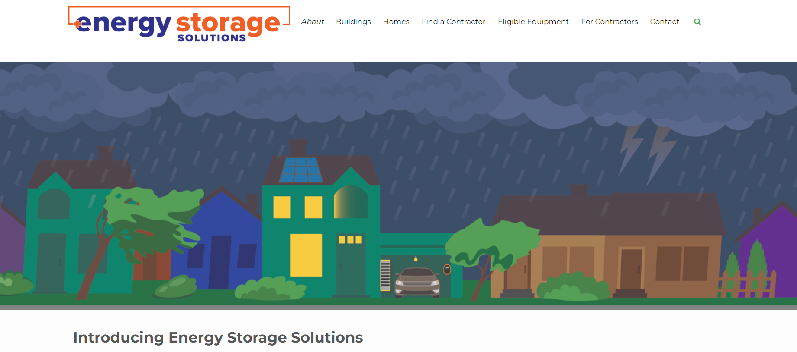
Website Walkthrough

Slide 12
Incentive Reservations & Estimates

Slide 13
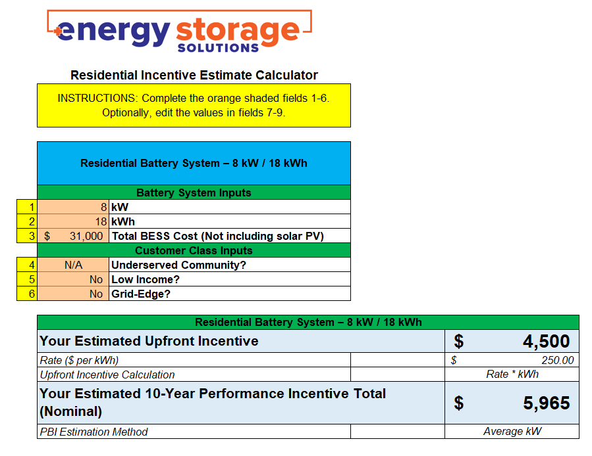
Incentive Calculator

Slide 14
Salesforce Demo
Energy Storage Solutions Contractor Portal

Slide 15
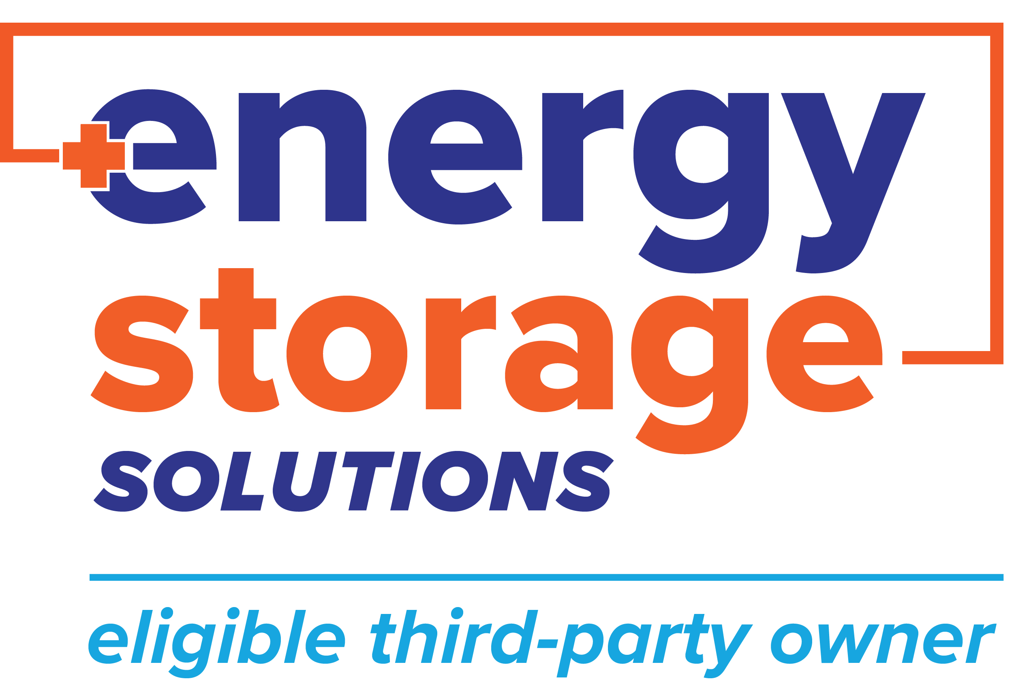
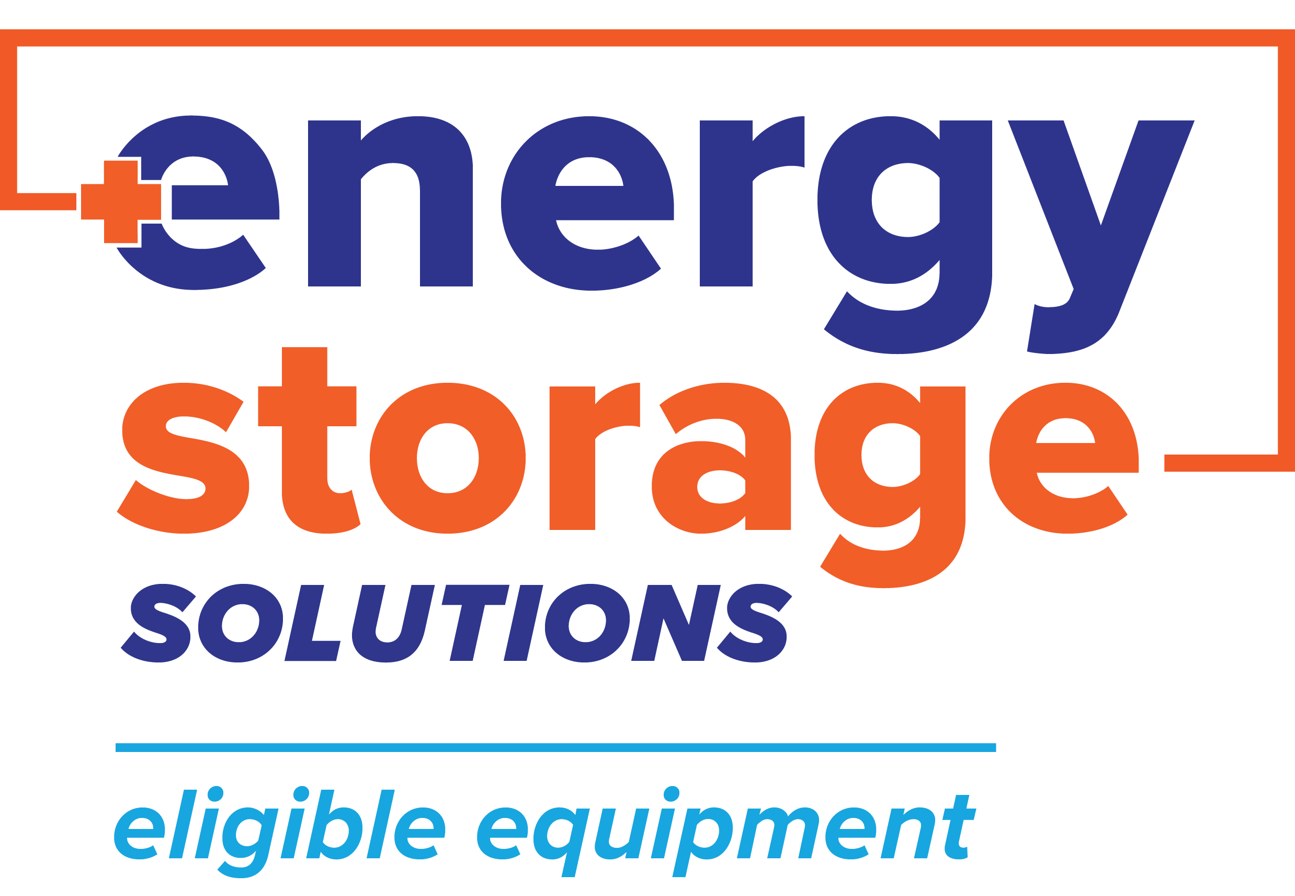
Energy Storage Solutions Cobranding
Use the Energy Storage Solutions logos in your marketing materials!
Visit www.energystoragect.com/cobranding-terms-and-conditions-form to request access

Slide 16
Questions? If so, please send in the chat or email to energystorage@ctgreenbank.com!

Slide 17
Appendix

Slide 18
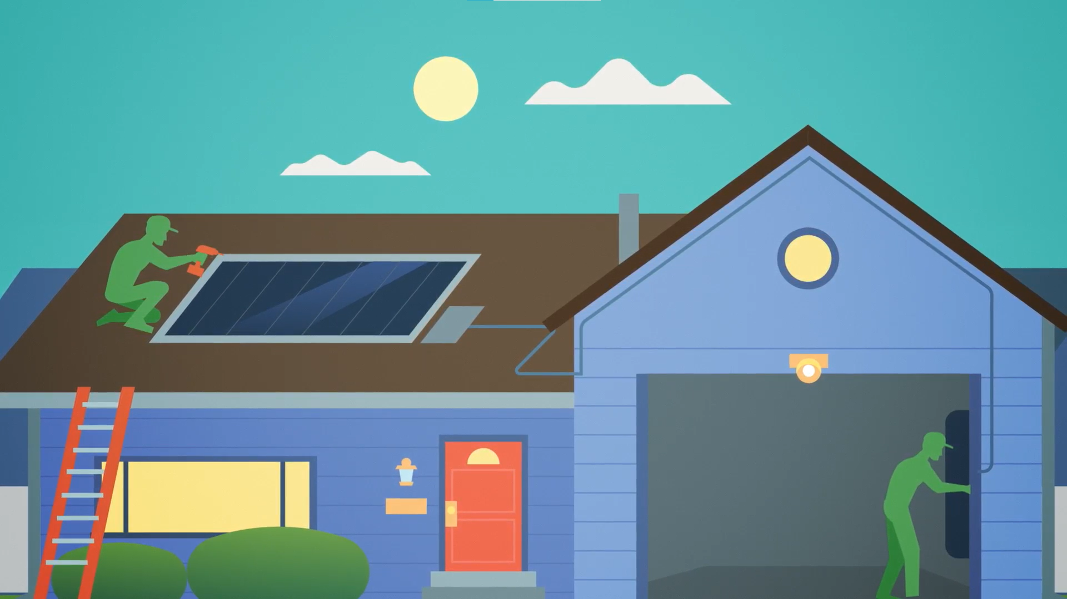

Slide 19
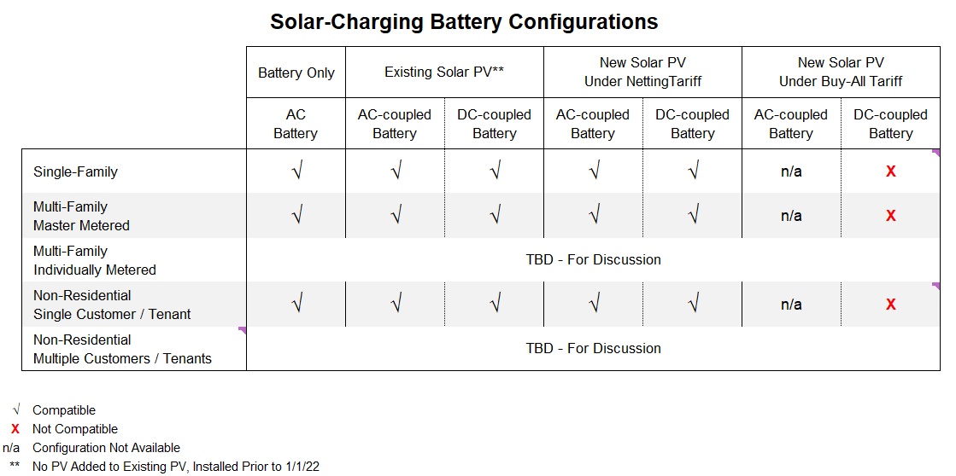
Battery Configurations

Slide 20
Application Approval Process Flow (without Salesforce stage names)
Check Eligible Battery List
New Technology Application (OEM Completes)
Program Admin Review
Technology
Pre-Approval
Integration with DERMS
ELIGIBILITY
Program Admins
Not on the list
Contractor
Inspector
Battery Vendor
On the list
Host Customer
Eligible Contractor Submits Project Application
CGB Application Review
Approval
Reservation of Funds Letter
Battery Installed & Energized
APPLICATION
Rejection
Letter of Rejection
Eligible Contractor Submits Completion Application
CGB Completion Review
Project moves into Inspection
Approval
COMPLETION
Rejection
Letter of Rejection
Project Inspection
Inspector completes Inspection
Battery Verification in DERMS
Confirmation of Funds Letter
Upfront Incentive Payment to Contractor
Program Participation
INSPECTION & VERIFICATION
Approval
Rejection
Inspection Corrections

Slide 21
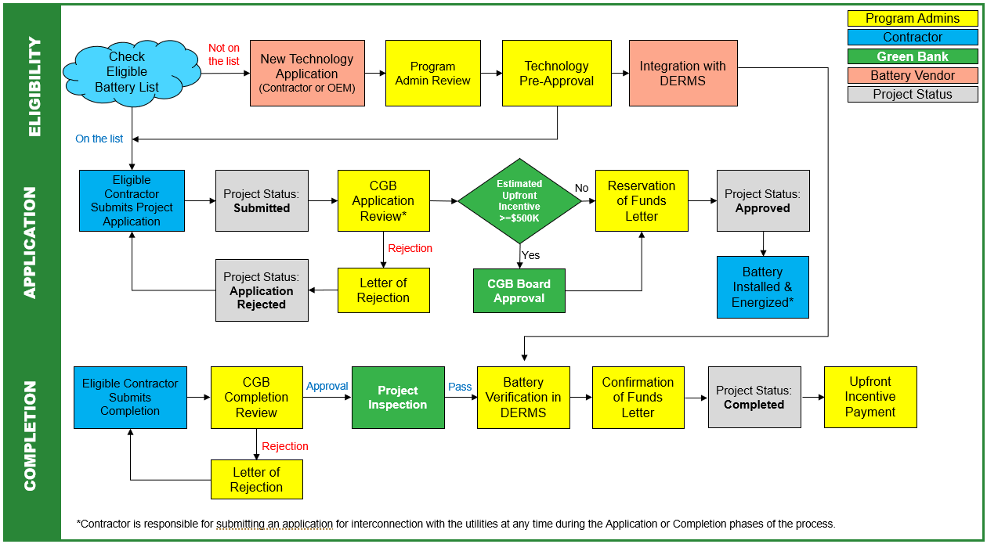
Process Flow

Slide 22
Application Approval Process Flow
Check Eligible Battery List
New Technology Application (OEM Completes)
Program Admin Review
Technology
Pre-Approval
Integration with DERMS
ELIGIBILITY
Program Admins
Not on the list
Contractor
Inspector
Battery Vendor
On the list
Host Customer
Eligible Contractor Submits Project Application
CGB Application Review
Approval
Reservation of Funds Letter
Battery Installed & Energized
APPLICATION
Rejection
Letter of Rejection
Eligible Contractor Submits Completion Application
CGB Completion Review
Project moves into Inspection
Approval
COMPLETION
Rejection
Letter of Rejection
Project Inspection
Inspector completes Inspection
Battery Verification in DERMS
Confirmation of Funds Letter
Upfront Incentive Payment to Contractor
Program Participation
INSPECTION & VERIFICATION
Approval
Rejection
Inspection Corrections

