Slide 1
Energy Storage Solutions November/December 2024 Contractor Training

Slide 2
Agenda
PURA updates
Quick Overview of ESS
Website Walkthrough
Incentive Calculator
Salesforce Training
Questions & Discussion

Slide 3
PURA Updates
Final Decision issued 12/4/2024 for Docket 24-08-05, Annual Energy Storage Solutions Program Review – Year 4
Additional updates to website and Program Manual coming soon!
100 Day Interconnection Sprint
Interconnection Report due to PURA by 12/21/2024 in both ESS & NRES

Slide 4
Final Decision Updates: Resi. / C&I
Passive Dispatch
Window will be 5 – 8 PM (previously 3 – 8 PM)
Changes to Passive dispatch and compliance (available capacity)
Updates to claw back formula – see Final Decision pg. 27 for details
New Incentive Calculator – easier to utilize with compliance warnings for both Resi/C&I, and updated rates for each step for C&I
Multi-Family Affordable Housing projects – owner to share resiliency benefits equitably with tenants. Email energystorage@ctgreenbank.com with any specific MFAH project questions before submitting
Passive Test Events (up to 2 optional events per year)
Eligible Systems: “Systems energized after January 1, 2022, but prior to the project’s contractor or equipment becoming approved (up to a maximum of one year) can be approved for an Upfront Incentive and provided their application is approved pursuant to Section 4. Such customers can be eligible for both Upfront and Performance Incentives at the rates in effect at the time of Reservation of Funds.”

Slide 5
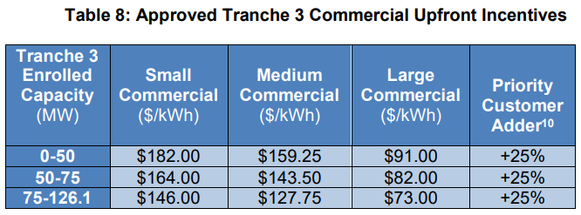
Final Decision Updates C&I
Upfront incentive rates immediately declining for the “Tranche 3” incentive block
Interconnection applications should be tracked and managed closely
Utilize the IX Working Group to resolve any IX issues
Eversource to resend any requests for incomplete/withdrawn ESS IX apps to the emails listed in PowerClerk by January 1, 2025
Applicants must respond within the 15-day timeframe to have Eversource reinstate these projects to their original queue positions prior to withdrawal

Slide 6
Energy Storage Solutions
9-year declining incentives – Goal of 580 MW behind-the-meter storage for residential and non-residential end-use customers
Statewide goal of 1000 MW, including front-of-the-meter
New Program MW Allocation
CUSTOMER CLASS​ | Tranche 1​ | Tranche 2​ | Tranche 3 | Tranche 4 | TOTAL​
Residential​ | 50 MW​ | 50 MW​ | 50 MW​ | 0 MW | 150 MW​
Commercial and Industrial​ | 50 MW​ | 113.9 MW​ | 126.1 MW​ | 140 MW | 430 MW​
Total​ | 100 MW​ | 163.9 MW​ | 176.1 MW​ | 140 MW | 580 MW ​

Slide 7
Program Design
Customer Classes:
Residential customer classes: Standard, Underserved, and Low-Income Households
Commercial/industrial customer classes: Small, Medium, Large (based on demand)
Systems installed through this program can receive two incentives:
Program Element | Design Item | Summer | Winter
Upfront Incentive (Passive Dispatch) | Events per Season | All non-holiday weekdays (~60) | N/A
 | Months | June, July & August | N/A
 | Event Duration | 3 Hours | N/A
 | Anticipated Dispatch Window | 5 PM to 8 PM | N/A
Performance-Based Incentive (Active Dispatch) | Events per Season | 30 to 60 | 1 to 5
 | Months | June through September | November through March
 | Event Duration | 1 - 3 hours | 1 - 3 hours
 | Anticipated Dispatch Window | Noon to 9 PM (All Days) | Noon to 9 PM (All Days)

Slide 8
Residential Incentive Levels
Upfront Incentive Levels (Tranche 1)*
Capacity Block (MW) | Standard | Underserved | Low-Income
10 | $250/kWh | $450/kWh | $600/kWh
15 | $212.5/kWh | $450/kWh | $600/kWh
25 | $162.5/kWh | $450/kWh | $600/kWh
Grid-Edge Adder | +50% | +50% | +50%
Performance Incentive Levels
Summer, Years 1-5 | Winter, Years 1-5 | Summer, Years 6-10 | Winter, Years 6-10
$200/kW | $25/kW | $115/kW | $15/kW
*Residential Upfront Incentive capped at $16,000 per household or 50% of total cost (whichever is less)

Slide 9
Residential – Notes & Webinars
Sunnova customers may only enroll through Sunnova
Customer Informational Webinars:
Please feel free to share this link with residential customers to learn more about the program and the benefits of battery energy storage systems. Most recent recorded session from the homeowner webinar held November 19:
https://energystoragect.com/informational-webinars/

Slide 10
Commercial Incentive Levels
Upfront Incentive Levels
Customer Class | Small C&I | Medium C&I | Large C&I
Peak Demand | <200 kW | 200-500 kW | >500 kW
Tranche 3 Step 1 (0-50 MW) | $182/kWh | $159.25/kWh | $91.00/kWh
Priority Customer Adder | +25% | +25% | +25%
Upfront Incentive (Installed 2022-2024)*
Performance Incentive Levels
Summer, Years 1-5 | Winter, Years 1-5 | Summer, Years 6-10 | Winter, Years 6-10
$200/kW | $25/kW | $115/kW | $15/kW
*Upfront Incentive capped at 50% of total cost

Slide 11
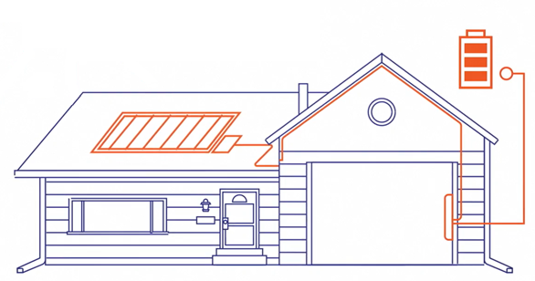
Approved Technology
Eligible Equipment List
Residential BESS OEMs:
Cadenza Innovation
EndurEnergy
Enphase
Fortress Power
FranklinWH
Generac PWRcell
Homegrid Energy
Panasonic Corporation
PylonTech + Sol-Ark 5k/15k inverters
Qcells
SolarEdge
StackRack + Sol-Ark 12k/15k inverters
Tesla *(Tesla Powerwall 2, Powerwall +, Powerwall 3 can only enroll in Active Dispatch and are not eligible for the Upfront Incentive through Passive Dispatch.)
C&I BESS OEMs:
BYD Energy Storage
Cadenza Innovation
Caterpillar Inc.
Canadian Solar
ELM Fieldsight
Generac Power Systems
Milton CAT
Relyion Energy
Socomec
Tesla (Megapack 2 only)
New Technology Application

Slide 12
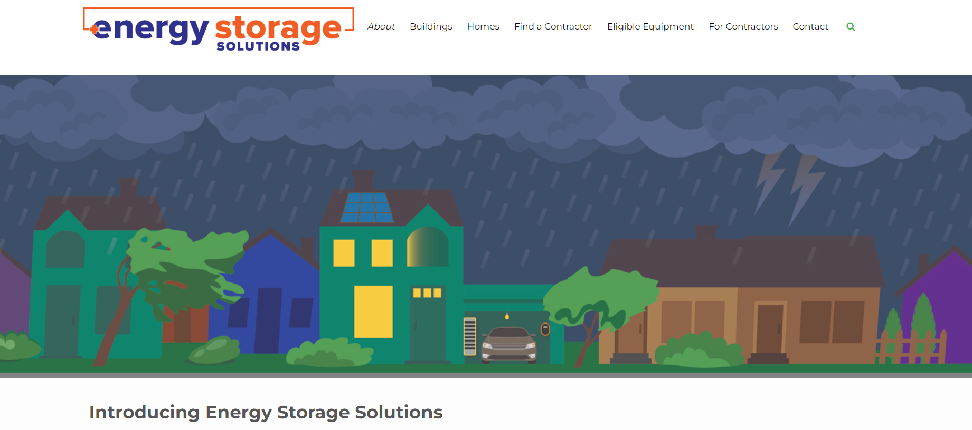
Website Walkthrough

Slide 13
Incentive Reservations & Estimates

Slide 14
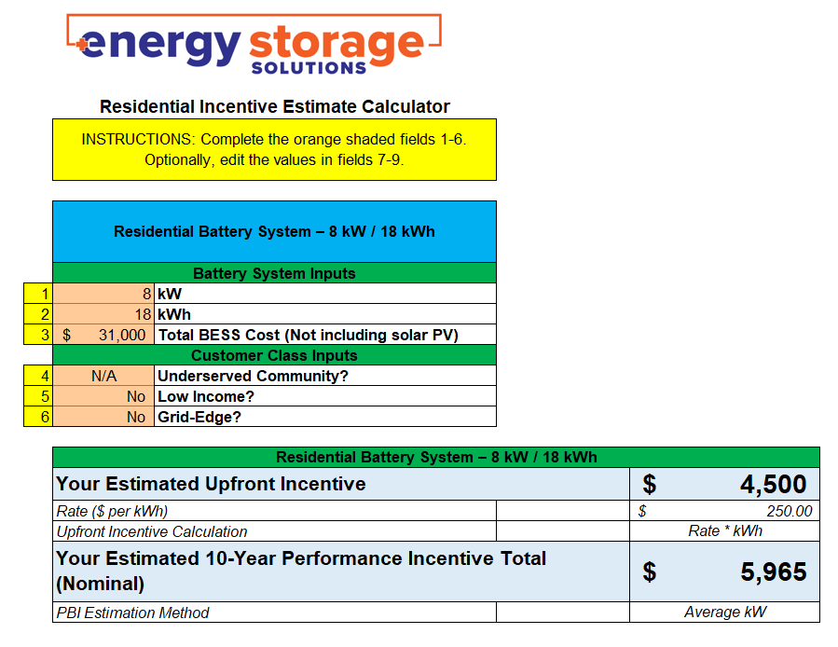
Incentive Calculator
New version to be posted to Contractor Resources page soon!
More user friendly
Guidance Warnings for system sizing
Future incentive steps included for C&I

Slide 15
Salesforce Demo
Energy Storage Solutions Contractor Portal

Slide 16
Energy Storage Solutions Cobranding
Use the Energy Storage Solutions logos in your marketing materials!
Visit www.energystoragect.com/cobranding-terms-and-conditions-form to request access

Slide 17
Questions? If so, please email to energystorage@ctgreenbank.com or place Q&A in Teams with your email address & we’ll send a reply if unable to cover in the session!

