Slide 1
Energy Storage Solutions March 2025 Contractor Training

Slide 2
Agenda
Quick Overview of ESS
Website Walkthrough
Incentive Calculator
Salesforce Training
Cobranding & Networking
Questions & Discussion

Slide 3
Energy Storage Solutions
9-year declining incentives – Goal of 580 MW behind-the-meter storage for residential and non-residential end-use customers
Program is overseen by PURA, paid for by electric ratepayers, and administered by Connecticut Green Bank, Eversource and UI
Track current capacity and other metrics for the program on the Reporting page
New Program MW Allocation
CUSTOMER CLASS​ | Tranche 1​ | Tranche 2​ | Tranche 3 | Tranche 4 | TOTAL​
Residential​ | 50 MW​ | 50 MW​ | 50 MW​ | 0 MW | 150 MW​
Commercial and Industrial​ | 50 MW​ | 113.9 MW​ | 126.1 MW​ | 140 MW | 430 MW​
Total​ | 100 MW​ | 163.9 MW​ | 176.1 MW​ | 140 MW | 580 MW ​

Slide 4
Program Design
Residential customer classes: Standard, Underserved, and Low-Income Households
Commercial/industrial customer classes: Small, Medium, Large (based on annual peak demand)
Systems may receive two (2) types of incentives through this program:
Program Element | Design Item | Summer | Winter
Upfront Incentive (Passive Dispatch) | Events per Season | All non-holiday weekdays (~60) | N/A
 | Months | June, July & August | N/A
 | Event Duration | 3 Hours | N/A
 | Anticipated Dispatch Window | 5 PM to 8 PM | N/A
Performance-Based Incentive (Active Dispatch) | Events per Season | 30 to 60 | 1 to 5
 | Months | June through September | November through March
 | Event Duration | 1 - 3 hours | 1 - 3 hours
 | Anticipated Dispatch Window | Noon to 9 PM (All Days) | Noon to 9 PM (All Days)

Slide 5
Residential Incentive Levels
Upfront Incentive Levels (Tranche 1)*
Capacity Block (MW) | Standard | Underserved | Low-Income
10 | $250/kWh | $450/kWh | $600/kWh
15 | $212.5/kWh | $450/kWh | $600/kWh
25 | $162.5/kWh | $450/kWh | $600/kWh
Grid-Edge Adder | +50% | +50% | +50%
Performance Incentive Levels
Summer, Years 1-5 | Winter, Years 1-5 | Summer, Years 6-10 | Winter, Years 6-10
$200/kW | $25/kW | $115/kW | $15/kW
*Residential Upfront Incentive capped at calculated incentive, $16,000 per household or 50% of total cost (whichever is less)

Slide 6
Residential – Notes & Webinars
Sunnova customers may only enroll through Sunnova
Tesla customers may only enroll through the Tesla Mobile App for Active-Only Dispatch to receive Performance Incentives
Multi-Family Affordable Housing projects – owner to share resiliency benefits equitably with tenants. Treated as residential low-income customer. Email energystorage@ctgreenbank.com with any specific MFAH project questions before submitting
Customer Informational Webinars:
Please feel free to share this link with residential customers to learn more about the program and the benefits of battery energy storage systems. Recorded session from the November 19th homeowner webinar:
https://energystoragect.com/informational-webinars/

Slide 7
Commercial Incentive Levels
Upfront Incentive Levels
Customer Class | Small C&I | Medium C&I | Large C&I
Peak Demand | <200 kW | 200-500 kW | >500 kW
Tranche 3 Step 1 (0-50 MW) | $182/kWh | $159.25/kWh | $91.00/kWh
Priority Customer Adder | +25% | +25% | +25%
Performance Incentive Levels
Summer, Years 1-5 | Winter, Years 1-5 | Summer, Years 6-10 | Winter, Years 6-10
$200/kW | $25/kW | $115/kW | $15/kW
*Upfront Incentive capped at calculated incentive or 50% of total cost

Slide 8
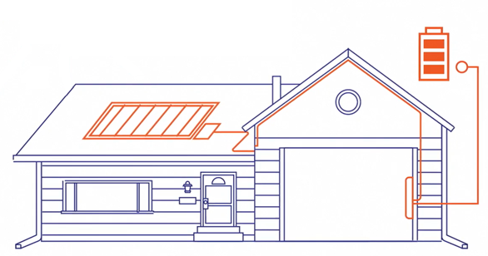
Approved Technology
Eligible Equipment List
Residential BESS OEMs:
Briggs & Stratton + Sol-Ark
Cadenza Innovation
EndurEnergy + Sol-Ark
Enphase
Fortress Power
FranklinWH
Generac PWRcell
Homegrid Energy+ Sol-Ark 12K
Panasonic Corporation
PylonTech + Sol-Ark 5k/15k inverters
Qcells
SolarEdge
StackRack + Sol-Ark 12k/15k inverters
Tesla *(Tesla Powerwall 2, Powerwall +, Powerwall 3 can only enroll in Active Dispatch and are not eligible for the Upfront Incentive through Passive Dispatch.)
C&I BESS OEMs:
American Energy Storage Innovations (AESI)
BYD Energy Storage
Cadenza Innovation
Caterpillar Inc.
Canadian Solar
ELM Fieldsight
Generac Power Systems
Milton CAT
Relyion Energy
Socomec
Tesla (Megapack 2 only)
New Technology Application

Slide 9
Passive Dispatch Webinar
Energy Storage Solutions Passive Dispatch Webinar
Virtual session held Wednesday, Feb. 5 at 12 pm EST
Watch recording here
In-Depth Overview of:
Recent changes to Passive Dispatch
Revised Passive Dispatch schedule
How future compliance will be measured, including incentive claw back
Questions and Discussion

Slide 10
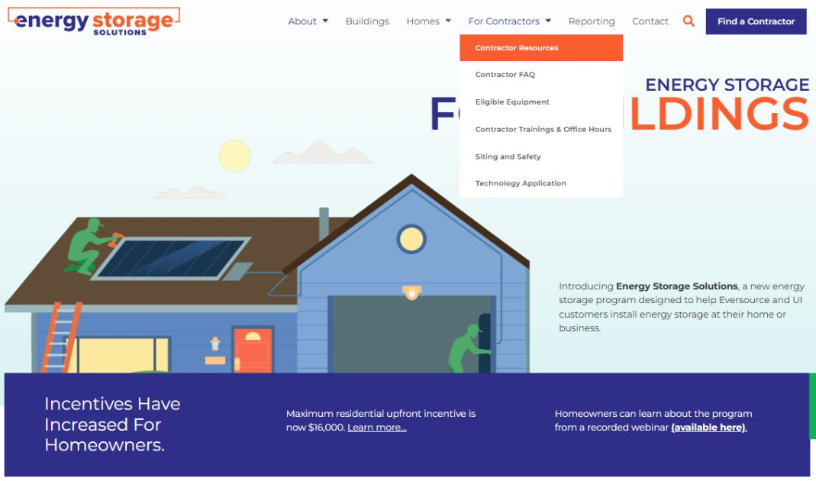
Website Walkthrough

Slide 11
Incentive Reservations & Estimates

Slide 12
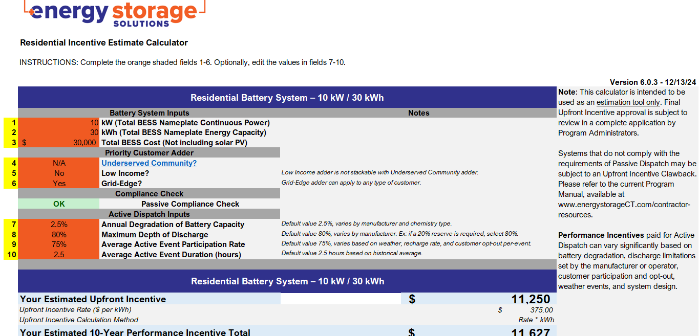
Incentive Calculator
New version posted to Contractor Resources page!
More user friendly
Guidance Warnings for system sizing
Future incentive steps included for C&I

Slide 13
150% or 2 MW Examples (p. 46 of Program Manual)
Example 5 – In the case of one 3 MW, 10 MWh battery for a large-sized Commercial grid-edge customer with an annual peak demand of 2 MW and an installed cost of $2,500,000 (Tranche 3 Step 1)
10,000 kWh * $91/kWh, or $910,000 +25% grid-edge adder = $1,137,500
50% of $2,500,000, or $1,250,000
The customer would receive an upfront incentive of $1,137,500
Example 6 – In the case of one 1.4 MW, 5 MWh battery for a small-sized Commercial small business customer with an annual peak demand of 180 kW and an installed cost of $1,950,000 (Tranche 3 Step 1)
System is > 150% of customer’s peak demand, but < 2 MW. Incentive cap not exceeded.
Tiered incentive calculation + 25% small business adder = $741,406
50% of $1,950,000, or $975,000
The customer would receive an upfront incentive of $741,406
Example 7 – In the case of one 3 MW, 15 MWh battery for a large-sized Commercial customer with an annual peak demand of 750 kW and an installed cost of $3,500,000 (Tranche 3 Step 1)
System is not capable of dispatching 80% of its capacity in a 3-hour passive dispatch window
System is > 150% of customer’s peak demand and > 2 MW, exceeding incentive cap
150% of peak demand = 1.125 MW. Capped system size is 2 MW
The project must be redesigned and resubmitted.

Slide 14
Submitting Applications – Salesforce Demo
Stages of an Incentive Enrollment Application in Salesforce:
Application in Progress
Application Submitted
Application Rejected
Installation in Progress
Completion Submitted (last stage contractors submit anything in the portal)
Completion Rejected
In Inspection (if opted in with the initial application question)
Pending DERMS (waiting on installer to register BESS w/DERMS through OEM)
Pending Payment (paid in monthly batches; see 2025 Upfront Payment Schedule
Project Complete
Energy Storage Solutions Contractor Portal

Slide 15
Changes to Application Process
Operational Agreement is no longer required for submission. If it’s noted as required in the portal, you may submit a duplicate or blank document in its place. We will be removing it from the required document list, soon.
Change Orders – For the interim, please email energystorage@ctgreenbank.com with any change orders (prior to PTO). Please include:
Previous and New: make, model, kW and kWh nameplate ratings
New Total BESS costs (prior to incentives) and Total PV costs (if applicable, so we may update those fields internally)
Any required documents impacted by the change order
More updates in progress!

Slide 16
Energy Storage Solutions Cobranding
Use the Energy Storage Solutions logos in your marketing materials!
Visit www.energystoragect.com/cobranding-terms-and-conditions-form to request access
Adding the General Connecticut Green Bank badge to also utilize!
If you have questions on cobranding for this program, or wish to discuss other Green Bank Solutions, please contact Julio.Cabrera@ctgreenbank.com

Slide 17
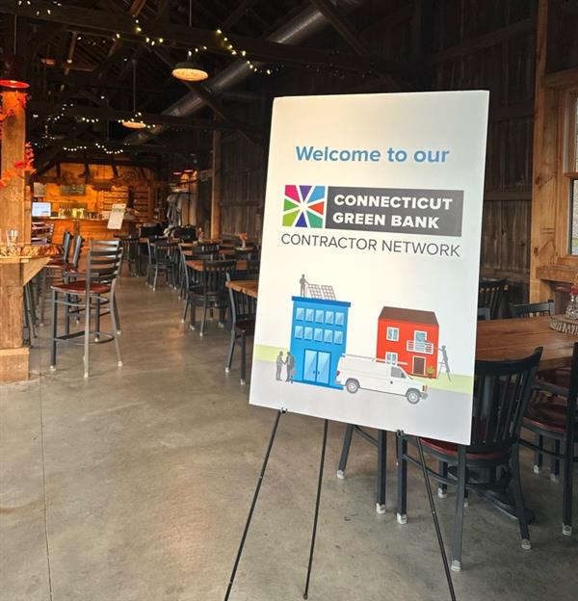
Contractor Networking Event
Wednesday, May 14th
5pm-8pm
Back 9 Social, Wallingford CT
Get ready for a fun evening of food, drinks, golf, and networking with the Connecticut Green Bank and our contractor network! Stay tuned for more information on how to register!

Slide 18
Questions? If unable to cover in this session, please email any questions to energystorage@ctgreenbank.com

Slide 19
Final Decision Updates: Resi. / C&I
Passive Dispatch
Window will be 5 – 8 PM (previously 3 – 8 PM)
Changes to Passive dispatch and compliance (available capacity)
Updates to claw back formula – If compliant with fewer than 90% of Passive event hours, 10% clawback is prorated to actual % shortfall
See Final Decision pg. 27 for details
New Incentive Calculator – easier to utilize with compliance warnings for both Resi/C&I, and updated rates for each step for C&I
Passive Test Events (up to 2 optional events per year)
Eligible Systems: “Systems energized after January 1, 2022, but prior to the project’s contractor or equipment becoming approved (up to a maximum of one year) can be approved for an Upfront Incentive and provided their application is approved pursuant to Section 4. Such customers can be eligible for both Upfront and Performance Incentives at the rates in effect at the time of Reservation of Funds.”

