Slide 1
Energy Storage Solutions June 2025 Contractor Training
June 26, 2025

Slide 2
Agenda
Quick Overview of ESS
Website Walkthrough
Incentive Calculator
Salesforce Training
Cobranding & Networking
Questions & Discussion

Slide 3
Energy Storage Solutions
9-year declining incentives – Goal of 580 MW behind-the-meter storage for residential and non-residential end-use customers
Program is overseen by PURA, paid for by electric ratepayers, and administered by Connecticut Green Bank, Eversource and United Illuminating (UI)
Track current capacity and other metrics for the program on the Reporting page
New Program MW Allocation
CUSTOMER CLASS​ | Tranche 1​ | Tranche 2​ | Tranche 3 | Tranche 4 | TOTAL​
Residential​ | 50 MW​ | 50 MW​ | 50 MW​ | 0 MW | 150 MW​
Commercial and Industrial​ | 50 MW​ | 113.9 MW​ | 126.1 MW​ | 140 MW | 430 MW​
Total​ | 100 MW​ | 163.9 MW​ | 176.1 MW​ | 140 MW | 580 MW ​

Slide 4
Program Design
Residential customer classes: Standard, Underserved, and Low-Income Households
Commercial/industrial customer classes: Small, Medium, Large (based on annual peak demand)
Systems may receive two (2) types of incentives through this program:
Program Element | Design Item | Summer | Winter
Upfront Incentive (Passive Dispatch) | Events per Season | All non-holiday weekdays (~60) | N/A
 | Months | June, July & August | N/A
 | Event Duration | 3 Hours | N/A
 | Anticipated Dispatch Window | 5 PM to 8 PM | N/A
Performance-Based Incentive (Active Dispatch) | Events per Season | 30 to 60 | 1 to 5
 | Months | June through September | November through March
 | Event Duration | 1 - 3 hours | 1 - 3 hours
 | Anticipated Dispatch Window | Noon to 9 PM (All Days) | Noon to 9 PM (All Days)

Slide 5
Residential Incentive Levels
Upfront Incentive Levels (Tranche 1)*
Capacity Block (MW) | Standard | Underserved | Low-Income
10 (~ 1 MW remaining) | $250/kWh | $450/kWh | $600/kWh
15 | $212.5/kWh | $450/kWh | $600/kWh
25 | $162.5/kWh | $450/kWh | $600/kWh
Grid-Edge Adder | +50% | +50% | +50%
Performance Incentive Levels
Summer, Years 1-5 | Winter, Years 1-5 | Summer, Years 6-10 | Winter, Years 6-10
$200/kW | $25/kW | $115/kW | $15/kW
*Residential Upfront Incentive capped at calculated incentive, $16,000 per household or 50% of total cost (whichever is less)

Slide 6
Residential – Notes & Webinars
**Standalone BESS** - If enrolling a standalone system, their may be additional electric costs incurred as it will always charge from the grid at retail and any excess exported energy is not compensated by a tariff as it is when paired with solar in RRES
Contract Requirements: view checklist here
New documents to utilize:
Self-Inspection Checklist (to submit with Completion Application)
UI residential customer enrollments: Residential Data Release and Terms and Conditions (as of 5/6/25)
Operational Agreement and Electric Utility Bill are no longer required for submission. If still required in the portal, you may submit a duplicate or blank doc. We will be removing from the required document list in future updates.
Tesla Powerwall 3 is now eligible for Passive dispatch enrollment to receive an upfront incentive in Eversource territory (UI territory will be following suit)
Customer Informational Webinars:
Please feel free to share this link with residential customers to learn more about the program and the benefits of battery energy storage systems. Recorded session from the March 26th homeowner webinar: https://energystoragect.com/informational-webinars/

Slide 7
Commercial Incentive Levels
Upfront Incentive Levels
Customer Class | Small C&I | Medium C&I | Large C&I
Peak Demand | <200 kW | 200-500 kW | >500 kW
Tranche 3 Step 1 (0-50 MW) | $182/kWh | $159.25/kWh | $91.00/kWh
Priority Customer Adder | +25% | +25% | +25%
Performance Incentive Levels
Summer, Years 1-5 | Winter, Years 1-5 | Summer, Years 6-10 | Winter, Years 6-10
$200/kW | $25/kW | $115/kW | $15/kW
*Upfront Incentive capped at calculated incentive or 50% of total cost

Slide 8
Other Notes & Webinars
You may verify Grid Edge locations (if mapping is unclear or if you just want to ensure it is definitely eligible) by emailing energystoragesolutions@ui.net and energystoragesolutions@eversource.com.
Always remember to check the Contractor Resources page of Program's website for updated materials and information!
Check out our new Resource Library to sort, search, and find the resources you’re looking for!
Multi-Family Affordable Housing projects – owner to share resiliency benefits equitably with tenants. Treated as residential low-income customer. Email energystorage@ctgreenbank.com with any specific MFAH project questions before submitting
*Webinar Recording & Slides (5/6/25):
Learn about Energy Storage Solutions for Commercial Customers

Slide 9
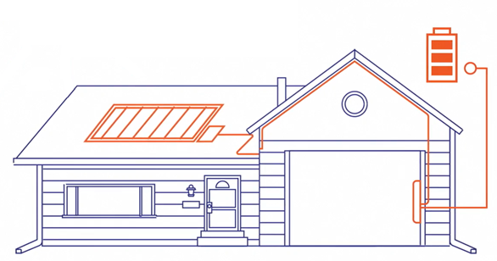
Approved Technology
Eligible Equipment List
Residential BESS OEMs:
Briggs & Stratton + Sol-Ark
Cadenza Innovation
Canadian Solar
Egauna Technologies
EndurEnergy + Sol-Ark
Enphase
Fortress Power
FranklinWH
Generac PWRcell
Homegrid Energy+ Sol-Ark
PylonTech + Sol-Ark 5k/15k inverters
Qcells
SolarEdge
StackRack + Sol-Ark 12k/15k inverters
Tesla *Tesla Powerwall 2, Powerwall +, Powerwall 3 can only enroll in Active Dispatch and are not eligible for the Upfront Incentive through Passive Dispatch in UI territory; Powerwall 3 is eligible for Upfront incentive if Eversource.
C&I BESS OEMs:
American Energy Storage Innovations (AESI)
BYD Energy Storage
Cadenza Innovation
Caterpillar Inc.
Canadian Solar
eCamion Inc.
ELM Fieldsight
Fortress Power
Generac Power Systems
Milton CAT
Relyion Energy
Socomec
Tesla (Megapack 2 only)
New Technology Application

Slide 10
Passive Dispatch Webinar
Energy Storage Solutions Passive Dispatch Webinar
Virtual session held Wednesday, Feb. 5 at 12 pm EST
Watch recording here
View Slides here
In-Depth Overview of:
Recent changes to Passive Dispatch
Revised Passive Dispatch schedule
How future compliance will be measured, including incentive claw back
Questions and Discussion

Slide 11
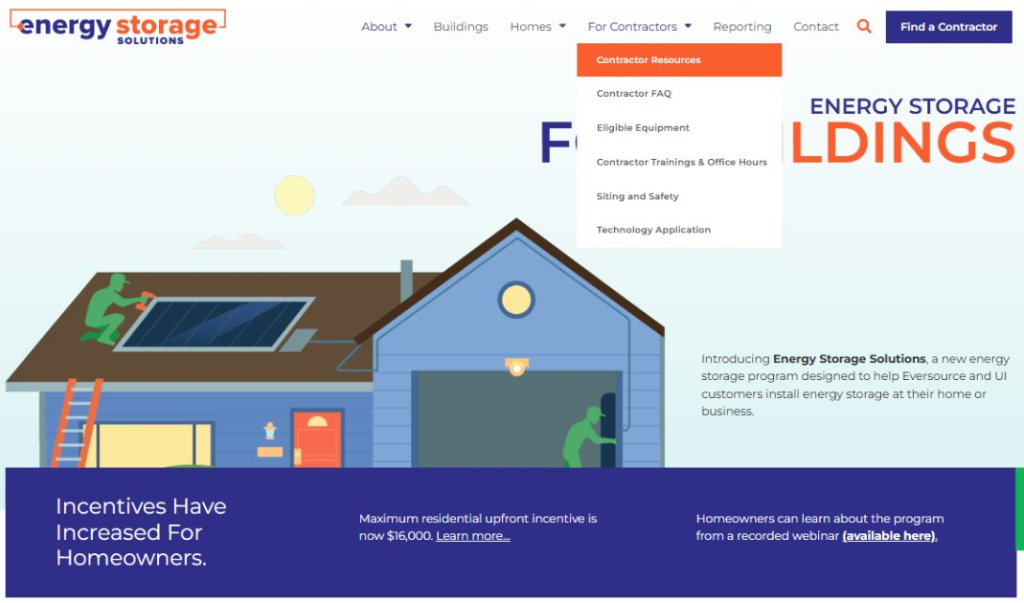
Website Walkthrough

Slide 12
Incentive Reservations & Estimates

Slide 13
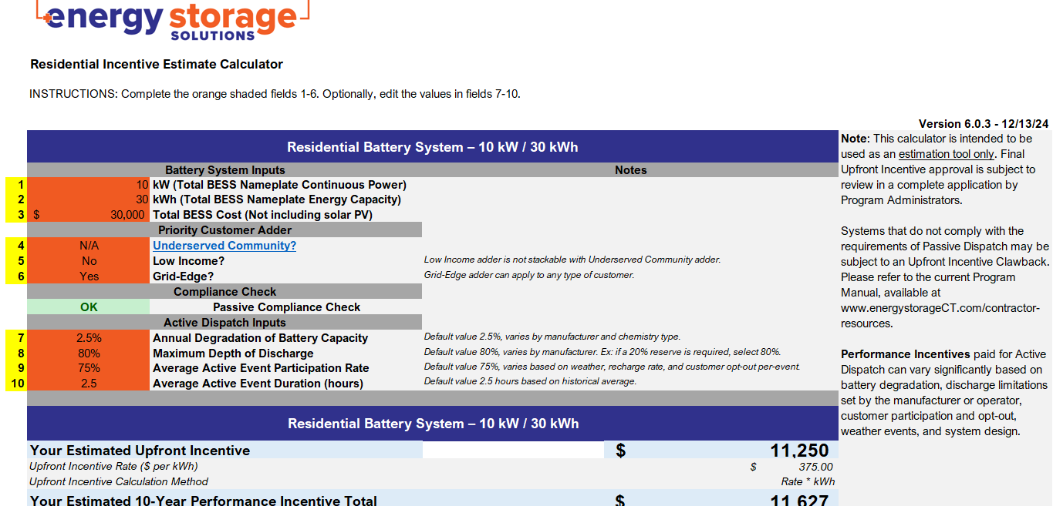
Incentive Calculator
New version posted to Contractor Resources page!
More user friendly
Guidance Warnings for system sizing
Future incentive steps included for C&I

Slide 14
150% or 2 MW Examples (p. 46 of Program Manual)
Example 5 – In the case of one 3 MW, 10 MWh battery for a large-sized Commercial grid-edge customer with an annual peak demand of 2 MW and an installed cost of $2,500,000 (Tranche 3 Step 1)
10,000 kWh * $91/kWh, or $910,000 +25% grid-edge adder = $1,137,500
50% of $2,500,000, or $1,250,000
The customer would receive an upfront incentive of $1,137,500
Example 6 – In the case of one 1.4 MW, 5 MWh battery for a small-sized Commercial small business customer with an annual peak demand of 180 kW and an installed cost of $1,950,000 (Tranche 3 Step 1)
System is > 150% of customer’s peak demand, but < 2 MW. Incentive cap not exceeded.
Tiered incentive calculation + 25% small business adder = $741,406
50% of $1,950,000, or $975,000
The customer would receive an upfront incentive of $741,406
Example 7 – In the case of one 3 MW, 15 MWh battery for a large-sized Commercial customer with an annual peak demand of 750 kW and an installed cost of $3,500,000 (Tranche 3 Step 1)
System is not capable of dispatching 80% of its capacity in a 3-hour passive dispatch window
System is > 150% of customer’s peak demand and > 2 MW, exceeding incentive cap
150% of peak demand = 1.125 MW. Capped system size is 2 MW
The project must be redesigned and resubmitted.

Slide 15
Submitting Applications – Salesforce Demo
Stages of an Incentive Enrollment Application in Salesforce:
Application in Progress
Application Submitted
Application Rejected
Installation in Progress
Completion Submitted (last stage contractors submit anything in the portal)
Completion Rejected
In Inspection (if opted in with the initial application question)
Pending DERMS (waiting on installer to register BESS w/DERMS through OEM)
Pending Payment (paid in monthly batches; see 2025 Upfront Payment Schedule
Project Complete
Energy Storage Solutions Contractor Portal

Slide 16
Changes to Application Process
MUST have interconnection application (for BESS ‘export’) submitted to utility PRIOR to submitting enrollment application to receive a Reservation of Funds (ROF)
Operational Agreement & Electric Bill are no longer required for submission. If still required in the portal, you may submit a duplicate or blank doc. We will be removing from the required document list, soon.
Change Orders – For the interim, please email energystorage@ctgreenbank.com with any change orders (prior to PTO). Please include:
Previous and New: make, model, kW and kWh nameplate ratings
New Total BESS costs (prior to incentives) and Total PV costs (if applicable, so we may update those fields internally)
Any required documents impacted by the change order
More updates in progress!

Slide 17
Tesla Powerwall 3
ONLY available for Upfront Incentive through Passive dispatch in Eversource territory (anticipating a launch for UI later this summer)
MUST have interconnection application (for BESS ‘export’) submitted to utility PRIOR to submitting enrollment application to receive a Reservation of Funds (ROF)
Contract must have the estimated upfront incentive applied as a discount to the total BESS costs if applying for Upfront incentive
If system was already energized, the PTO must be June 5th or later
No Data Release T&C form required for Tesla apps in our portal as that is executed and recorded through the Tesla Mobile App
When system has PTO, the customer will need to self-enroll through Tesla Mobile App in their Virtual Power Plant (“VPP”) section

Slide 18
Pending DERMS
Final step before we can move project into Pending Payment
Contractor and customer must register the BESS through the battery inverter OEM's process
Best if done at time of commissioning when system receives PTO
Contact battery inverter's OEM for support (each OEM has a different process)
Some resources available:
FranklinWH
Tesla

Slide 19
Payment Processing
Upfront Incentive funds will be disbursed per the Payment Schedule if everything is submitted by the completion paperwork due date.
To help prevent delays or issues with receiving your first payment from this program via ACH, please ensure your eligible company completes the W-9 form and submits to Ariel.Schneider@ctgreenbank.com before the completion paperwork due date.
Email energystorage@ctgreenbank.com for a copy of the form; we will see if we can also post to contractor resources page.

Slide 20
Energy Storage Solutions Cobranding
Use the Energy Storage Solutions logos in your marketing materials!
Visit www.energystoragect.com/cobranding-terms-and-conditions-form to request access
Now including the Connecticut Green Bank Contractor Network badge to utilize!
If you have questions on cobranding for this program, or wish to discuss other Green Bank Solutions, please reach out to energystorage@ctgreenbank.com and we will put you in contact with the appropriate department.
Sample
Sample

Slide 21
Questions? If unable to cover in this session, please email any questions to energystorage@ctgreenbank.com

Slide 22
Final Decision Updates: Resi. / C&I
Passive Dispatch
Window will be 5 – 8 PM (previously 3 – 8 PM)
Changes to Passive dispatch and compliance (available capacity)
Updates to claw back formula – If compliant with fewer than 90% of Passive event hours, 10% clawback is prorated to actual % shortfall
See Final Decision pg. 27 for details
New Incentive Calculator – easier to utilize with compliance warnings for both Resi/C&I, and updated rates for each step for C&I
Passive Test Events (up to 2 optional events per year)
Eligible Systems: “Systems energized after January 1, 2022, but prior to the project’s contractor or equipment becoming approved (up to a maximum of one year) can be approved for an Upfront Incentive and provided their application is approved pursuant to Section 4. Such customers can be eligible for both Upfront and Performance Incentives at the rates in effect at the time of Reservation of Funds.”

